Slide 1
Breaking Barriers through Better Communication
Transforming Tech Teams
Presented by Chris Steele
Notes:
Mention that this is an interactive talk

Slide 2
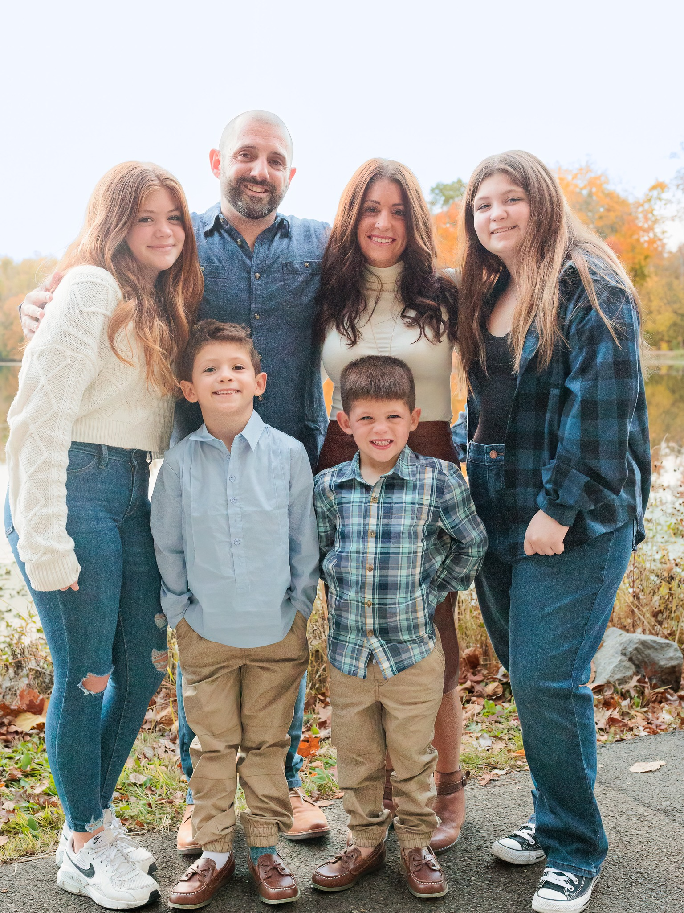
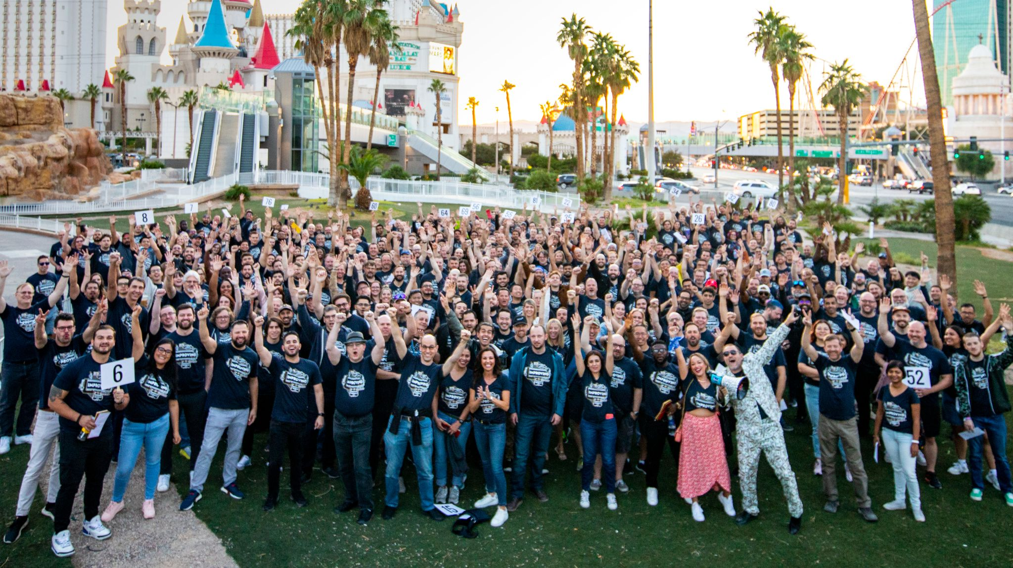
About me
Notes:
Briefly summarize why I want to talk about this
Talk about what you don’t see about my background – lived in 9 places by 10yrs – strict stepdad – bi-polar dad – mom thoughts?
Most of what we talk about are things I’ve learned along my journey

Slide 3
Today’s focus
What is communication?
Why does communication fail?
How can we do better?

Slide 4
What is communication?
A process by which information is exchanged between individuals through a common system of symbols, signs, or behavior – Merriam-Webster
Notes:
Dig into this with the audience – what’s missing? Is this accurate?

Slide 5
What does this look like in tech teams?
Agile ceremonies
Code reviews
Scoping sessions
1:1’s
And More

Slide 6
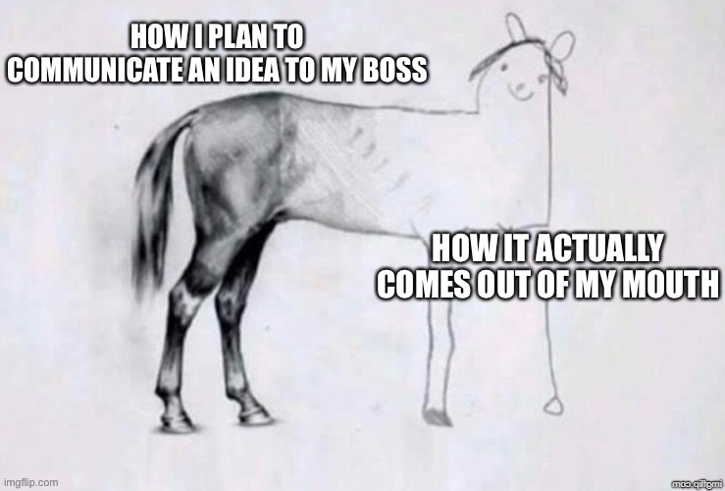
Why does communication fail?
Not listening
Lack of trust
Disagreements
Misunderstanding
Arrogance
Intent not clear
Not a good day
Notes:
Ask the audience
Language barrierrs
Lack of engagement
Unstated assumptions
Just don't care

Slide 7
How can we do better?
Become aware
Leverage known strategies
Choose different words/phrases

Slide 8



But wait…
Notes:
Set the stage on the fact that it starts with self
Image from DALL E 2: “Create an image of someone who has the desire to become a better version of themselves each day. They are considered a kaizen.”
Second one, used DALL-E 3
Third one, dropped the “They are considered a kaizen”

Slide 9
Awareness

Slide 10
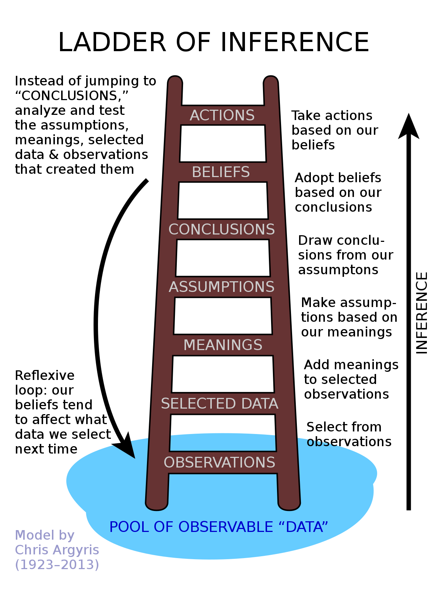
Ladder of Inference
Stop
Identify
Reflect down
Reflect up
Notes:
Talk about an example with driving a car in traffic
Model describing how we make judgements about decisions – cognitive biases – 2 + 2 = 5
EXAMPLE:

Slide 11

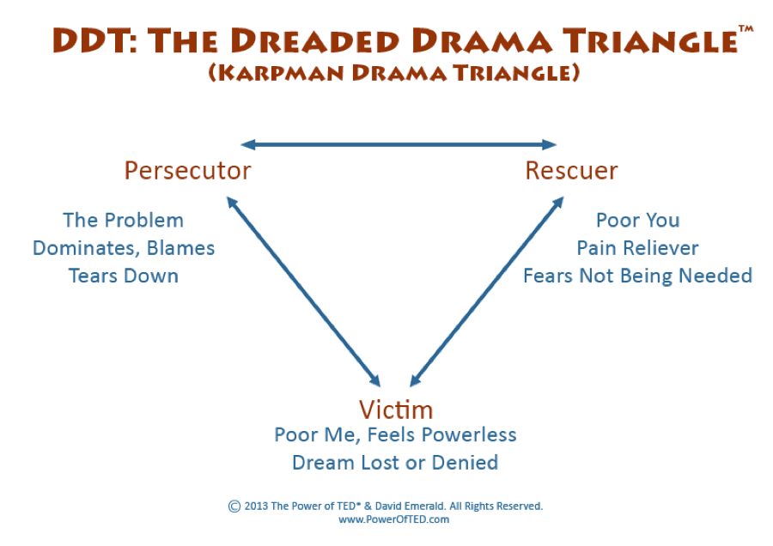
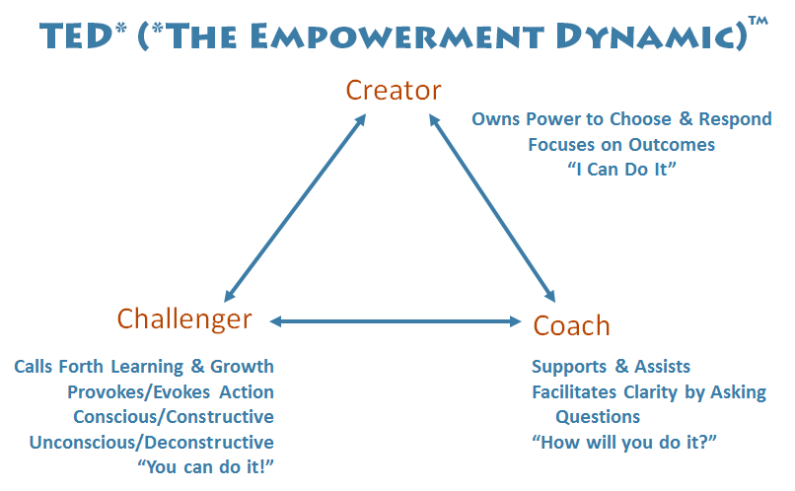
Power of TED

Slide 12
Strategies

Slide 13
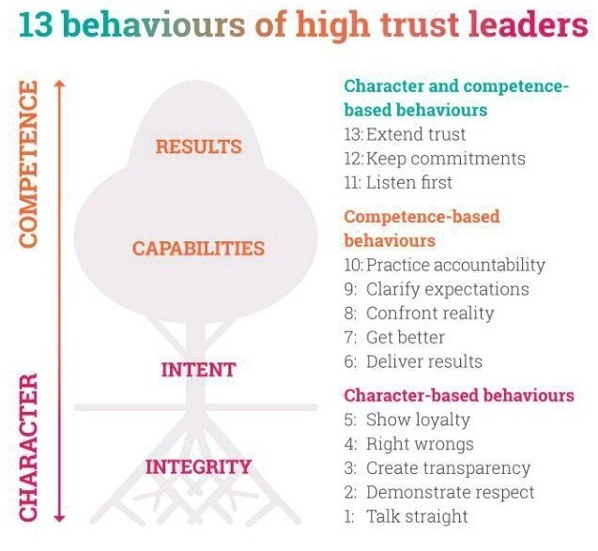

Speed of Trust

Slide 14
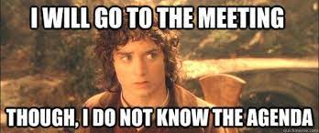
When in Meetings
Have an agenda or meeting strategy
Choose the right people
Leaders talk first and then last
Ask open-ended questions
Use "yes and" approach
End with recap, commitments, accountability, and timelines
Notes:
Mention “Death by Meetings” by Patrick Lencioni - Daily Check-in, weekly tactical, monthly strategy, quarterly off-site review
Ask the audience
TODO: Update
Add:
Start and end on time

Slide 15
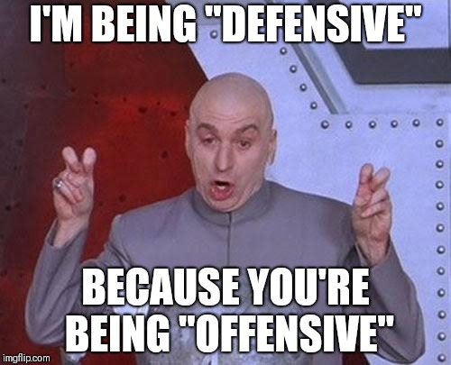
Preventing Defensiveness
LISTEN
PAUSE
Agree with the person
Acknowledge their feelings
Tell them what you’ve learned/heard
Tell them how helpful it was
What else?
Notes:
Active listening – Seek first to understand
Ask the audience
ADD:
Avoid accusations
Tone
Eye contact

Slide 16
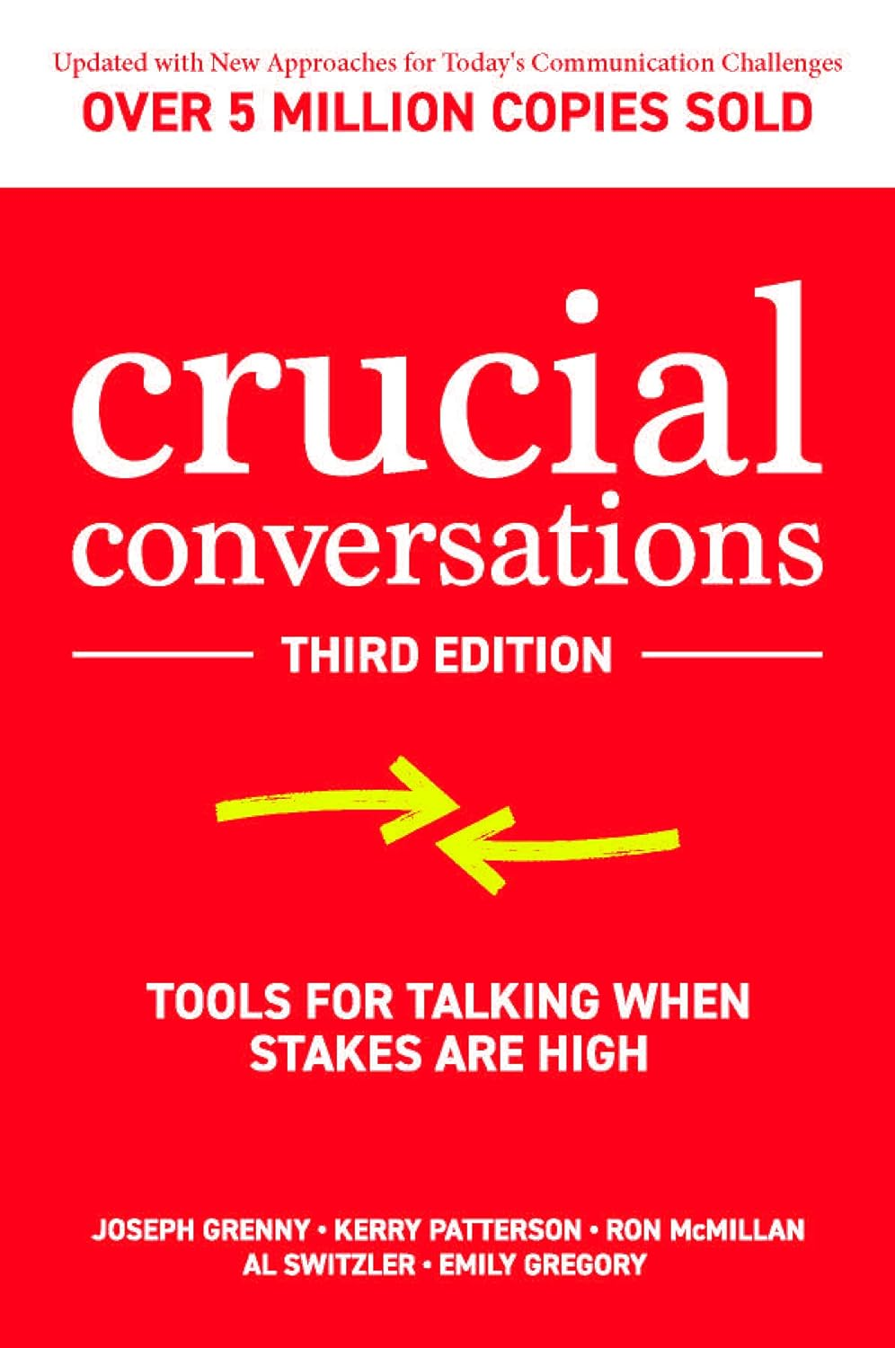
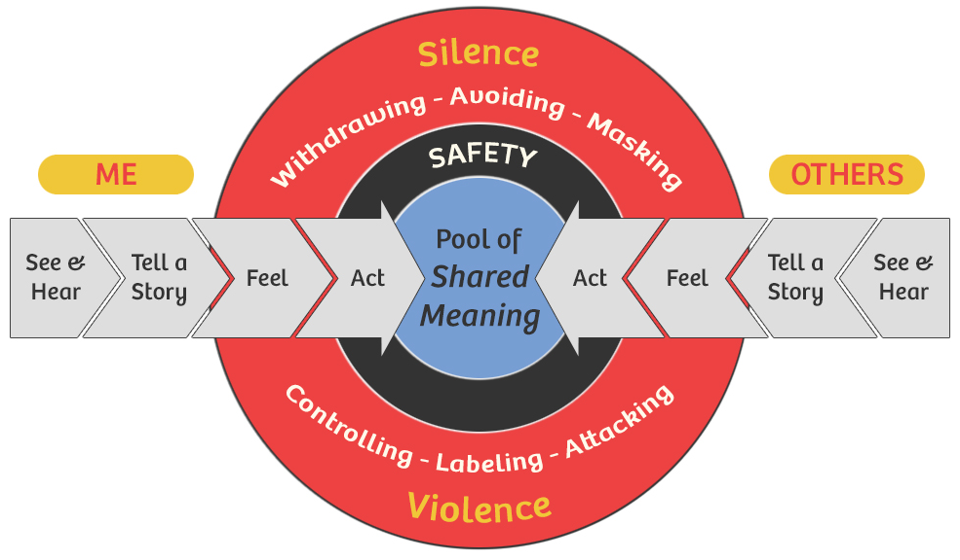
Crucial Conversations

Slide 17
Word Choices

Slide 18
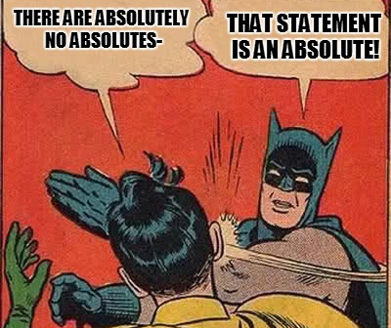
Remove Absolutes
Always / Never
Everyone / No One
Anything / Everything
Impossible
What else?
Notes:
Personal pet peeve

Slide 19
Phrases
To avoid
Why…
I’m too busy…
Unfortunately…
You should…
…But…
Notes:
Special mentions:
* Unfortunately - sets up negative path
I'm sorry - guard for when you need to be
What are your concerns?

Slide 20
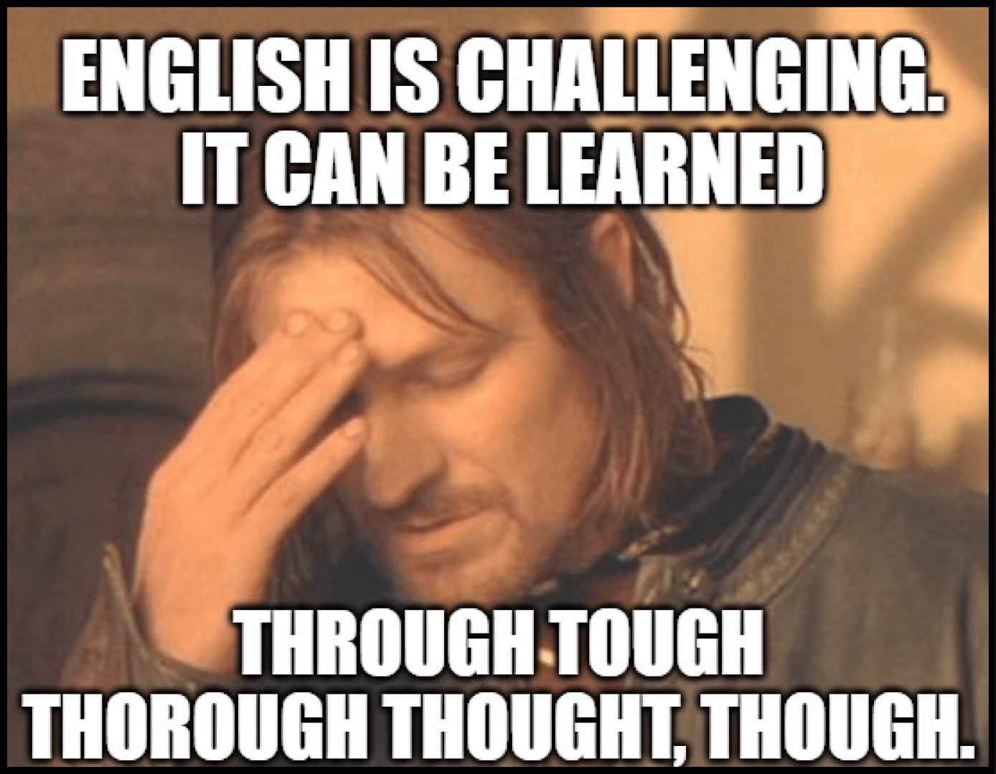
Words are hard!
Just
Kind of
Trust/believe me
No offense
To be honest
Obviously
What else?

Slide 21
Special Mention

Slide 22
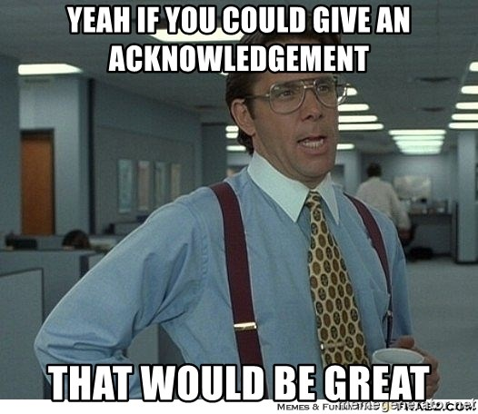
Acknowledgment
Notes:
This is what really inspired the talk

Slide 23
What are some of your techniques?

Slide 24
What did we learn?
Ladder of inference
Power of TED
Self
Awareness
Strategies
Word choices
<insert yours>
Speed of Trust
Effective meetings
Preventing defensiveness
Crucial Conversations
Remove absolutes
Change phrases
Avoid certain words
Notes:
Don’t forget to mention self!

Slide 25
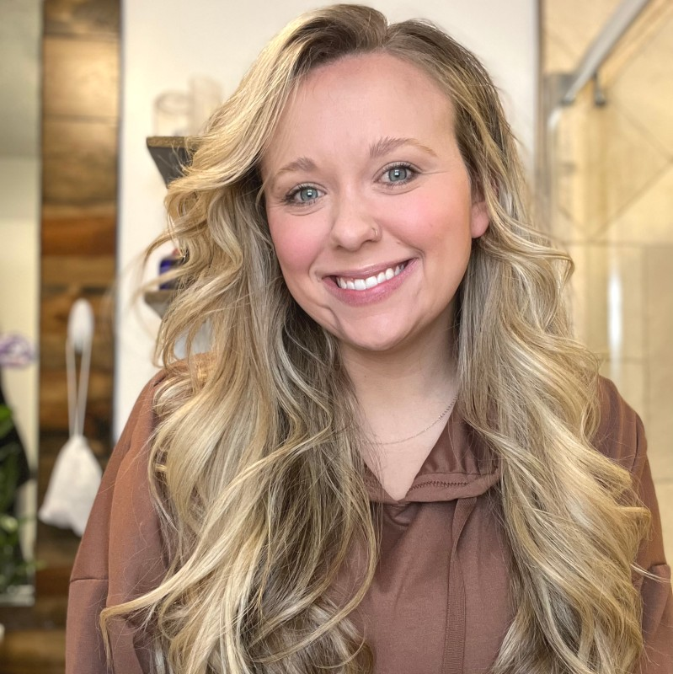
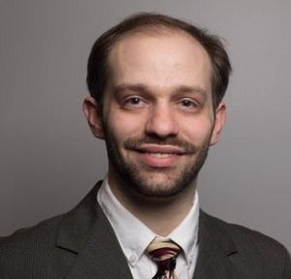
Shout-out
Talks to see tomorrow – 5/25!
9:00 am – Amanda Lange
The Power of Listening: Improving Communication in the Tech Industry
10:30 am – Kyle Jenkins
From Blind Trust to Real Trust: Practical Steps for IT Teams

Slide 26
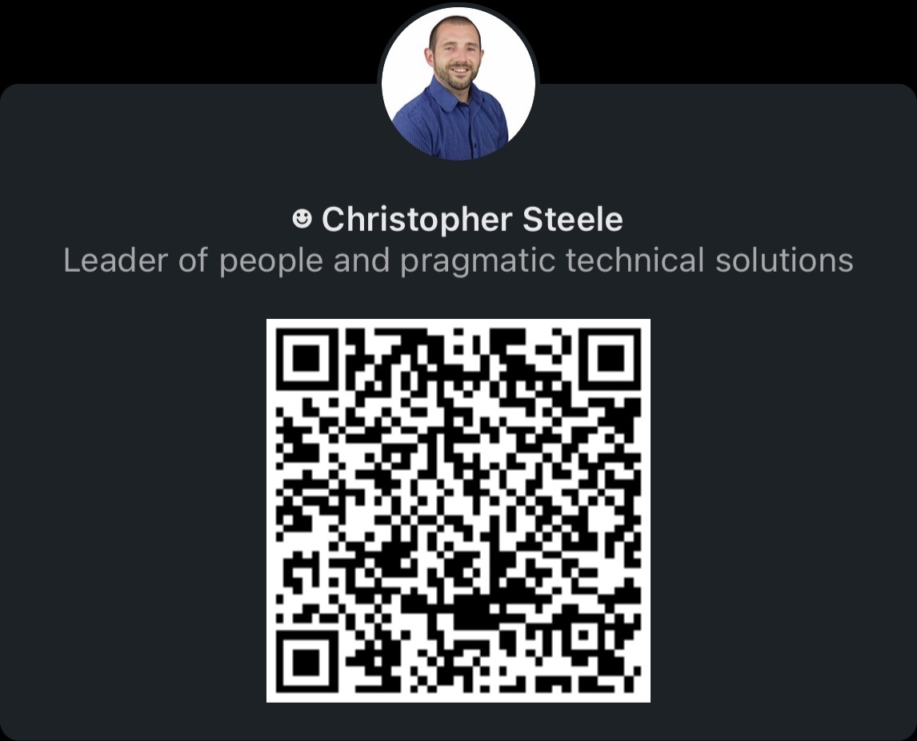
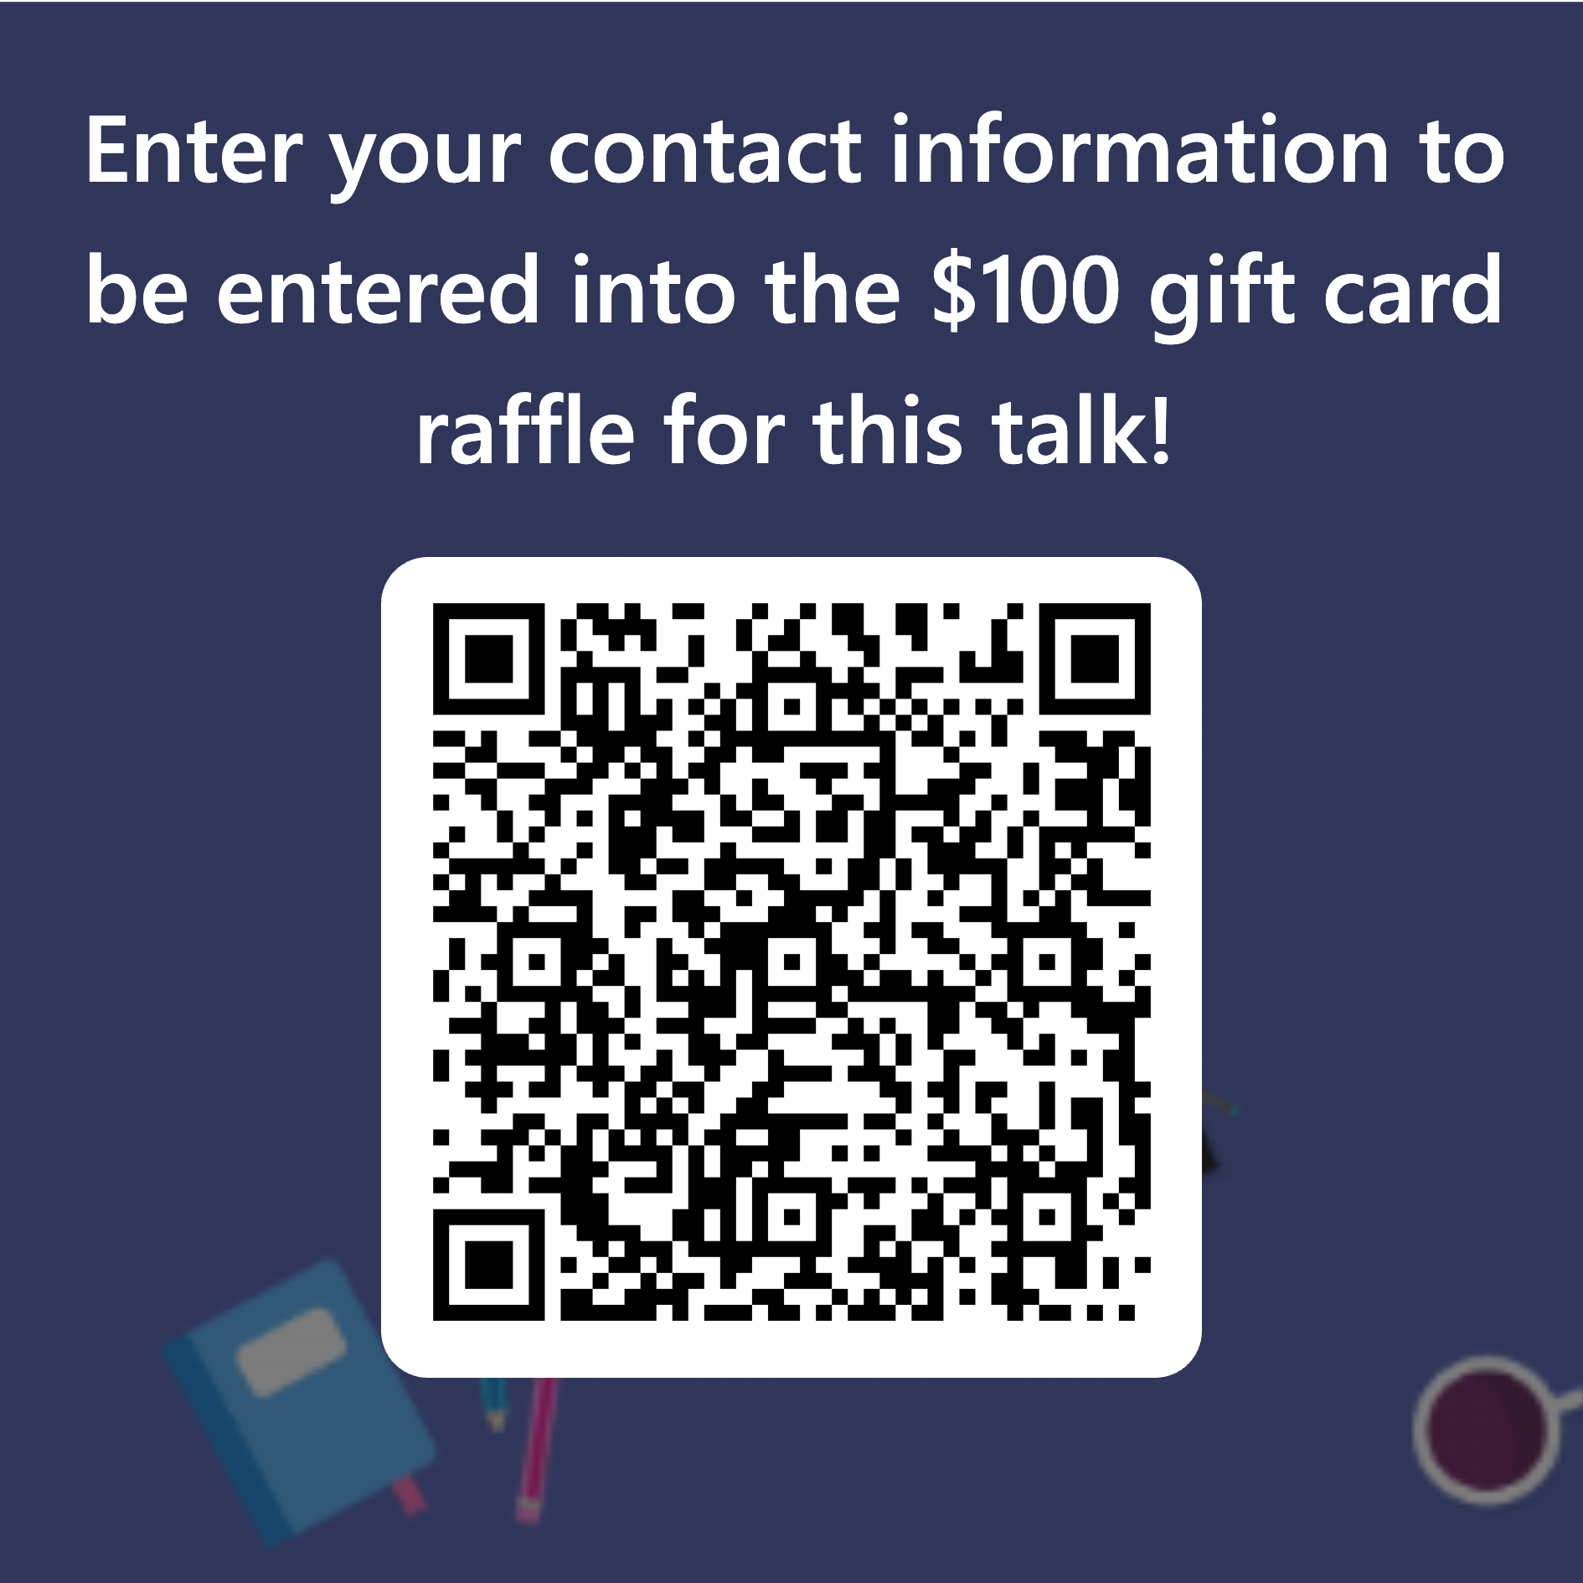
Thank you!
Notes:
Changes for future talks:
Add a crucial conversation slide
Add a non-verbal slide

Slide 27
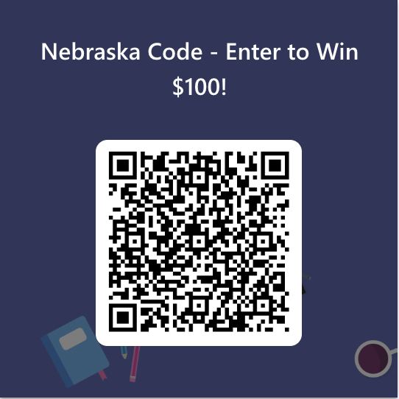
Thank you!
Notes:
Changes for future talks:
Add a non-verbal slide

Slide 28
Thank you!!
Questions??

